Slide 1


How to Take an
Interim Assessment During Distance Learning
2021-22 School Year
Assessment & Research
CLIMATE | CULTURE | SYSTEMS | INSTRUCTION

Slide 2
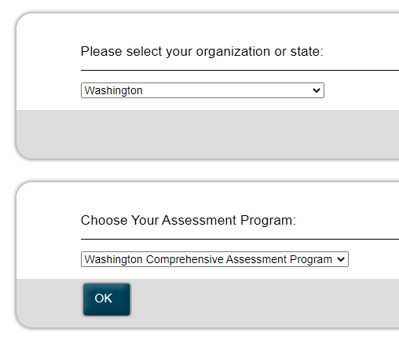
Navigate to Cambium Assessment Page
https://mobile.tds.cambiumast.com/launchpad/
Select Washington
Select Ok

Slide 3
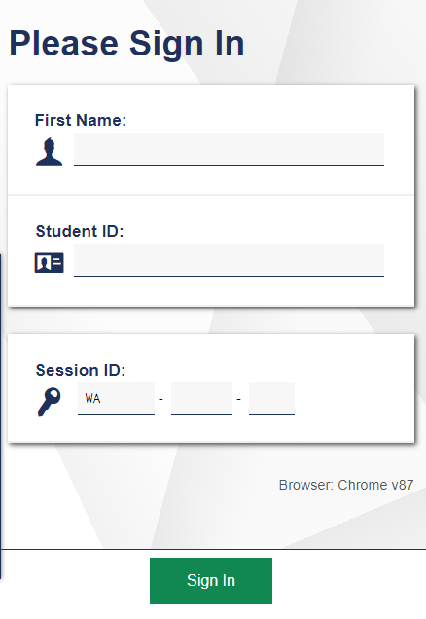
Sign In
Enter the following information:
Enter First Name
Enter 10-digit student ID (found in Home Access Center)
Enter Session ID from teacher
Select the Sign In button

Slide 4
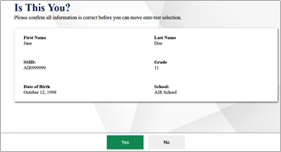
Verify Your Information
Is your information correct?
If yes, select Yes button.
If no, tell the teacher.

Slide 5
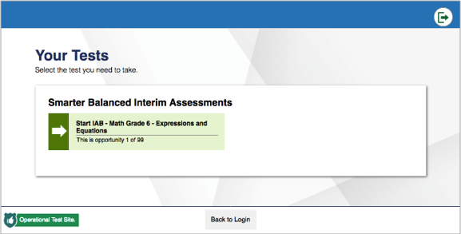
Select Test
Select the test you need to take

Slide 6
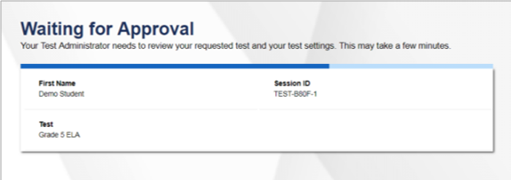
Wait for Your Teacher

Slide 7
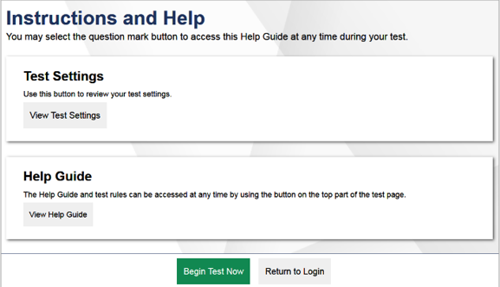
Begin Test
Select Begin Test Now.
Your teacher will watch your progress throughout testing.

